Slide 1
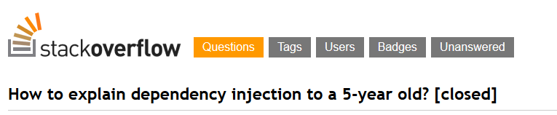
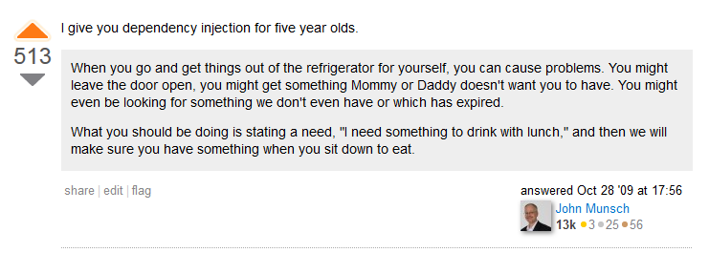
http://stackoverflow.com/questions/1638919/how-to-explain-dependency-injection-to-a-5-year-old/1638961#1638961

Slide 2

Dependency Injection, the right way
Thibaud DESODT
@tsimbalar
Notes:
Present you self

Slide 3
This talk
What it is about
Dependency Injection patterns
Benefits
Common pitfalls
What it is not about
Specific IoC/DI Container implementations
Pre-requisites
OOP
Class-based statically-typed languages
Based on examples
Notes:
Talk about Dependency Injection
Dependency Injection patterns
You may know about it under a form or another, or ay have used tools
Who has ?
You must unlearn ! Need to understand the philosophy and concepts in order to use the tools properly
It’s easy to misuse the tools and miss some benefits

Slide 4


Slide 5
Dependency Injection
What ?

Slide 6
Dependency Injection (DI)
Dependency Injection is a set of practices that allow to build loosely coupled applications

Slide 7
Dependency Injection
Dependency Injection is a set of practices that allow to build loosely coupled applications
It’s NOT :
A library
A framework
A tool
It IS :
A way of thinking
A way of designing code
General guidelines

Slide 8
Dependency Injection
Dependency Injection is a set of practices that allow to build loosely coupled applications
Small components …
Independent
Reusable
Interchangeable
… plugged together to form a bigger system
Benefits :
Small classes with single responsibility
Easier maintenance
Extensibility
Testable by definition
Notes:
Comment :
First encounter with need for loosely coupled code came from unit tests
Who write unit tests here ? Anybody who writes unit tests first ?
First encounter where you code MUST BE loosely coupled : unit tests ! Actually consume components out of the scope of the application
Tightly coupled code is hard to test or not testable at all … if it’s testable it’s not too tightly coupled

Slide 9
Loosely coupled code
Independent components
Reusable
Interchangeable
Glued together to form a bigger system
TODO: image ? Big containing application + components that do not really know each other’s internals
Ultimate goal :
Maintainability : change should impact only a module
Make the system evolve without pain
Notes:
Comment :
First encounter with need for loosely coupled code came from unit tests
Who write unit tests here ? Anybody who writes unit tests first ?
First encounter where you code MUST BE loosely coupled : unit tests ! Actually consume components out of the scope of the application
Tightly coupled code is hard to test or not testable at all … if it’s testable it’s not too tightly coupled

Slide 10
From Tightly to Loosely Coupled
Show me the code !

Slide 11
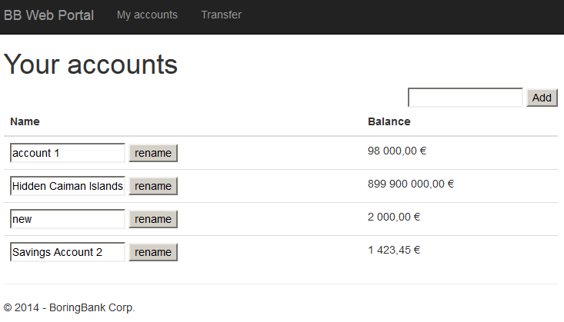
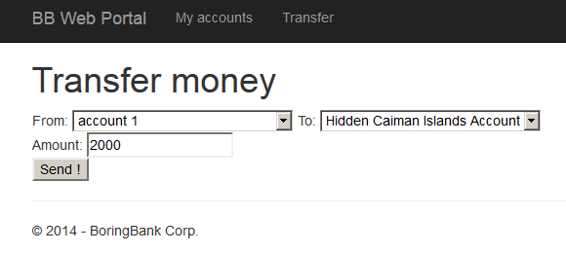
Example : Boring Bank™ System
Features
User can list his accounts
User can rename his accounts
User can transfer money from an account to the other
Tech :
Web front-end
Relational database

Slide 12
Starting from scratch
public class AccountController : BaseController
{
// GET: Account
[HttpGet]
public ActionResult Index()
{
var userId = this.User.AsClaimsPrincipal().UserId();
using (var context = new BankingDbContext())
{
var accounts = context.Accounts
.Where(a => a.CustomerId == userId)
.OrderBy(a => a.Title).ToList();
return View(accounts);
}
}
[HttpPost]
public ActionResult TransferPost(int from, int to, decimal amount)
{
var userId = this.User.AsClaimsPrincipal().UserId();
using (var context = new BankingDbContext())
{
var accountFrom = context.Accounts
.Single(a => a.CustomerId == userId && a.Id == from);
var accountTo = context.Accounts
.Single(a => a.CustomerId == userId && a.Id == to);
accountFrom.Balance -= amount;
accountTo.Balance += amount;
context.SaveChanges();
return RedirectToAction("Index");
}
}
data
business
presentation
Notes:
Let’s see …
Inside a controller
Creating a dbcontext (Entity Framework) … imagine if that was ADO .NET
Selecting a few things
Passing it to the view…
Has anybody ever written code like that ?
That’s only a read page … imagine action with side effects…
Simplified, no error handling whatsoever
You may argue that it is loosely coupled … there’s only one class … but what a class !

Slide 13
Tightly-coupled code
Using another kind of UI ?
Using another kind of storage ?
Using the business rules somewhere else ?
Changing the business rules ?

Slide 14
Separation of Concerns
Layered architecture / split assemblies
Presentation
Business
Data-access
Separated :
Persistence Entities
Domain Entities
View Models
Notes:
Turned spaghetti into lasagna ☺

Slide 15
public class AccountController : BaseController
{
// GET: Account
[HttpGet]
public ActionResult Index()
{
var userId = this.User.AsClaimsPrincipal().UserId();
var userAccountService = new UserAccountService();
var accounts = userAccountService.GetAccountsForCustomer(userId);
return View(ToViewModel(accounts));
}
[HttpPost]
public ActionResult TransferPost(int from, int to, decimal amount)
{
var userId = this.User.AsClaimsPrincipal().UserId();
var userAccountService = new UserAccountService();
userAccountService.Transfer(userId, from, to, amount);
return RedirectToAction("Index");
}
AccountController.cs (WebPortal)
public Account GetAccountForCustomer(int customerId, int accountId)
{
using (var context = new BankingDbContext("BankingDbContext"))
{
var account = context.Accounts
.Single(a => a.CustomerId == customerId && a.Id == accountId);
return account;
}
}
public void Update(Account account)
{
using (var context = new BankingDbContext("BankingDbContext"))
{
var accountEf = context.Accounts.Find(account.Id);
// theoretically, could do "if not changed"
accountEf.Balance = account.Balance;
accountEf.Title = account.Title;
context.SaveChanges();
}
}
AccountRepository.cs (Data)
public void Transfer(int userId, int fromAccountId, int toAccountId, decimal amountToTransfer)
{
// TODO : validate arguments
var accountRepository = new AccountRepository();
var fromAccount = accountRepository.GetAccountForCustomer(userId, fromAccountId);
var toAccount = accountRepository.GetAccountForCustomer(userId, toAccountId);
// TODO : verify that there is enough money
fromAccount.Balance -= amountToTransfer;
toAccount.Balance += amountToTransfer;
accountRepository.Update(fromAccount);
accountRepository.Update(toAccount);
}
UserAccountService.cs (Business)
UI talks to Business
Business talks to Data

Slide 16
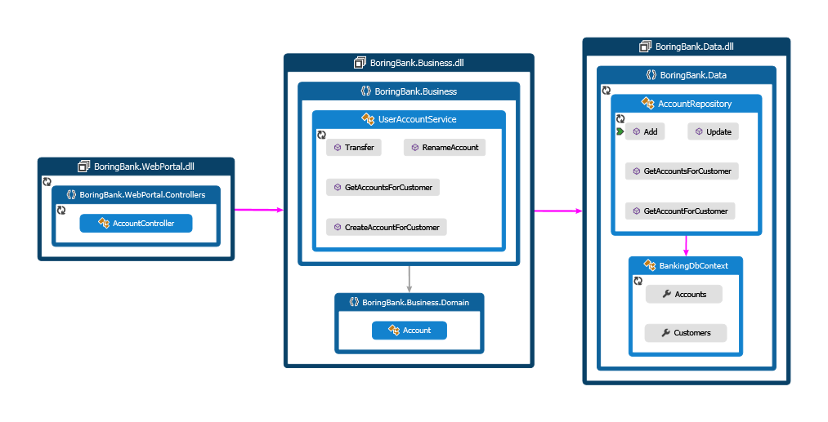
That looks fine … but is it ?
Notes:
Business depends on Data layer … it should be an implementation detail
Presentation depends on Business which depends on Data … which depends on EF … we’ll see that a bit later
But mostly about using components in isolation … this is not testable right now

Slide 17
anti-pattern : Control Freak
“Control-Freak” anti-pattern
Code insists on how the dependencies are built
Makes it impossible to use component in isolation
Not testable without full stack
Easy to spot : “new” everywhere

Slide 18
Unit tests as a Coupling Detector
Unit-tests are “just another client” for your code
If unit-tests are hard to write, the code is probably too tightly coupled

Slide 19
Making it testable - Properties
public class UserAccountService
{
public UserAccountService()
{
AccountRepository = new AccountRepository("BankingContext");
}
#region Dependency Management
public AccountRepository AccountRepository { get; set; }
#endregion
[TestMethod]
public void RenameAccount_must_UpdateAccountName()
{
// Arrange
var newName = "someName";
var existingAccount = AnAccount();
var sut = new UserAccountService();
sut.AccountRepository = FAIL FAIL//I want to put a fake here !
// Act
sut.RenameAccount(existingAccount.CustomerId, existingAccount.Id, newName);
// Assert
// I want to verify what happened ..
}
In UserAccountServiceTest.cs , in test project Business.Tests
Settable property allows
to “inject” another instance
Notes:
Note that even though we introduced interfaces, we still have a hard reference between all projects

Slide 20
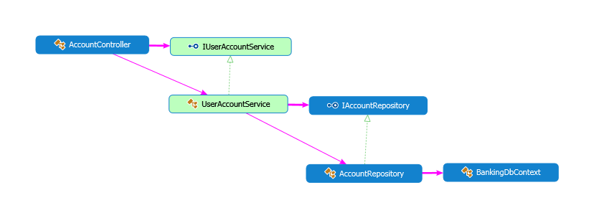
Programming to an interface
public class UserAccountService : IUserAccountService
{
public UserAccountService()
{
AccountRepository = new AccountRepository("BankingContext");
}
#region Dependency Management
public IAccountRepository AccountRepository { get; set; }
#endregion
[TestMethod]
public void RenameAccount_must_UpdateAccountName()
{
// Arrange
var newName = "someName";
var existingAccount = AnAccount();
var mockRepo = new Mock<IAccountRepository>();
mockRepo.Setup(r => r.GetAccountForCustomer(It.IsAny<int>(), It.IsAny<int>()))
.Returns(existingAccount);
var sut = new UserAccountService();
sut.AccountRepository = mockRepo.Object; //I want to put a fake here !
// Act
sut.RenameAccount(existingAccount.CustomerId, existingAccount.Id, newName);
// Assert
mockRepo.Verify(r=> r.Update(It.Is<Data.Account>(a=> a.Title == newName)));
}
Use an interface (or abstract class) instead of concrete class
Inject fake instance
Notes:
Interface of abstract class ….
I can’t do new I…..
The closest we can get is this ….

Slide 21
pattern : Property Injection
Expose settable properties to modify dependencies
Benefits
Useful to provide optional extensibility
There must be a good “local default” implementation
Caveats
Not very easy to discover point of extension
Easy to forget
Extra care to avoid NullReferenceExceptions, handle thread-safety etc

Slide 22
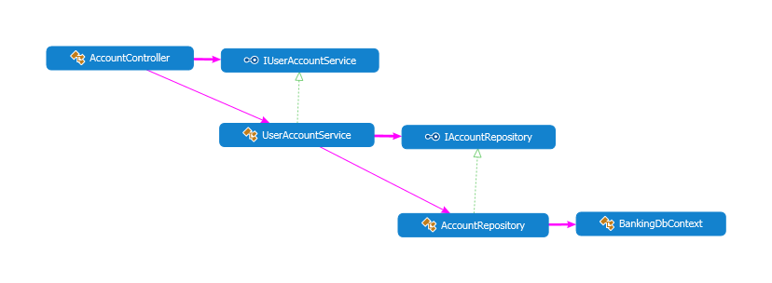
Making it more explicit - Constructor
public class UserAccountService : IUserAccountService
{
private readonly IAccountRepository _accountRepository;
public UserAccountService(IAccountRepository accountRepository)
{
if (accountRepository == null) throw new ArgumentNullException("accountRepository");
_accountRepository = accountRepository;
}
public UserAccountService()
:this(new AccountRepository("BankingContext"))
{
}
#region Dependency Management
public IAccountRepository AccountRepository { get { return _accountRepository; } }
#endregion
[TestMethod]
public void RenameAccount_must_UpdateAccountName()
{
// Arrange
var newName = "someName";
var existingAccount = AnAccount();
var mockRepo = new Mock<IAccountRepository>();
mockRepo.Setup(r => r.GetAccountForCustomer(It.IsAny<int>(), It.IsAny<int>()))
.Returns(existingAccount);
var sut = new UserAccountService(mockRepo.Object);
// Act
sut.RenameAccount(existingAccount.CustomerId, existingAccount.Id, newName);
// Assert
mockRepo.Verify(r=> r.Update(It.Is<Data.Account>(a=> a.Title == newName)));
}
Injection constructor
used in tests - declare required dependencies as constructor parameters
Default constructor
used in production code
Inject fake instance

Slide 23
anti-pattern : Bastard Injection
Paradox:
Lots of efforts to reduce coupling
… but forcing a hard-coded value
Code just there for tests but not use in production
Notes:
Used in default Visual Studio Template for MVC apps until not so long ago

Slide 24
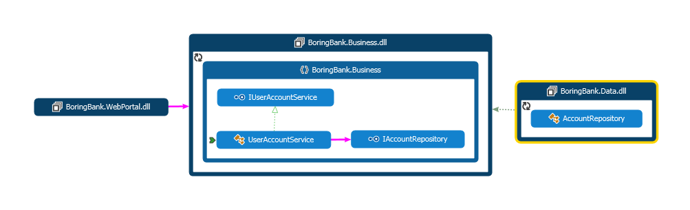
Cutting the dependency chain
public class AccountController : BaseController
{
private readonly IUserAccountService _userAccountService;
public AccountController(IUserAccountService userAccountService)
{
if (userAccountService == null) throw new ArgumentNullException("userAccountService");
_userAccountService = userAccountService;
}
AccountController (WebPortal)
public class UserAccountService : IUserAccountService
{
private readonly IAccountRepository _accountRepository;
public UserAccountService(IAccountRepository accountRepository)
{
if (accountRepository == null) throw new ArgumentNullException("accountRepository");
_accountRepository = accountRepository;
}
UserAccountService.cs (Business)

Slide 25
pattern : Constructor Injection
Declare required dependencies as constructor parameters
Declarative
Discoverable (intellisense, Reflection …)
Type-safe
Recommended approach in 99.9% of cases
Need Guard clause because C# does not support non-nullable reference types …
Notes:
If you remember one thing, it’s that !

Slide 26
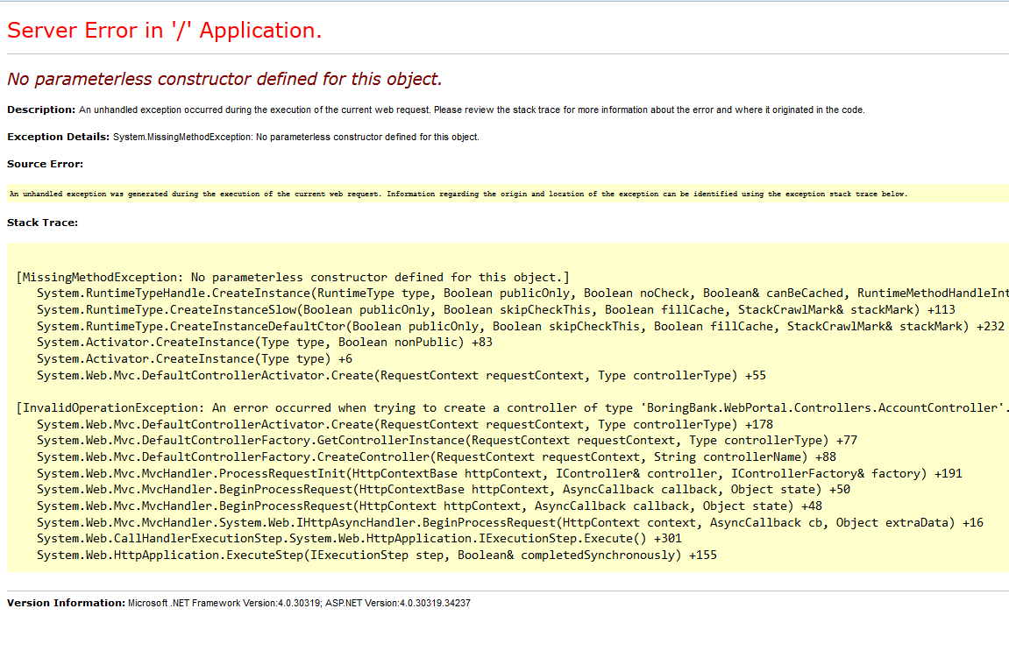
This is great and everything except …
[InvalidOperationException: An error occurred when trying to create a controller of type 'BoringBank.WebPortal.Controllers.AccountController'. Make sure that the controller has a parameterless public constructor.]
System.Web.Mvc.DefaultControllerActivator.Create(RequestContext requestContext, Type controllerType) +178
System.Web.Mvc.DefaultControllerFactory.GetControllerInstance(RequestContext requestContext, Type controllerType) +77
System.Web.Mvc.DefaultControllerFactory.CreateController(RequestContext requestContext, String controllerName) +88

Slide 27
The chicken and the egg
Applications do not work with only interfaces
Class instances have to be created and assembled (=composed) at some point
This happens only in one place in an app / web app / service / console app

Slide 28
pattern : Composition Root
Composition of classes into a larger system should happen only in one place
Create one* object-graph
There is no composition root in a library
Only « applications » have a Composition Root
Where the Composition Root can be plugged depends on the kind of app
The Composition Root needs access to all concrete types

Slide 29
ASP.NET MVC Composition Root
public class AppCompositionRoot : DefaultControllerFactory
{
protected override IController GetControllerInstance(RequestContext requestContext,
Type controllerType)
{
// how to compose an AccountController ?
if (controllerType == typeof(AccountController))
{
var connectionString = ConfigurationManager
.ConnectionStrings["BankingDbContext"].ConnectionString;
var repo = new AccountRepository(connectionString);
var service = new UserAccountService(repo);
return new AccountController(service);
}
// standard way in MVC to use default strategy
return base.GetControllerInstance(requestContext, controllerType);
}
}
IControllerFactory
Called on each request to create an instance of a controller matching URL
DefaultControllerFactory expects default constructor on Controller
But it can be changed !
public class MvcApplication : System.Web.HttpApplication
{
protected void Application_Start()
{
var factory = new AppCompositionRoot();
ControllerBuilder.Current.SetControllerFactory(factory);
In Global.asax
Controller
composition
tell MVC to use our composition root

Slide 30
Pure DI
Manual wiring of dependencies
Also known as Poor Man’s DI
Very explicit
Type-safe
… but repetitive and boring

Slide 31
So what ?
And we did that because … ?

Slide 32
Many benefits of full DI-friendly codebase
Testability
Maintainability
Allows parallel work
… and more !

Slide 33
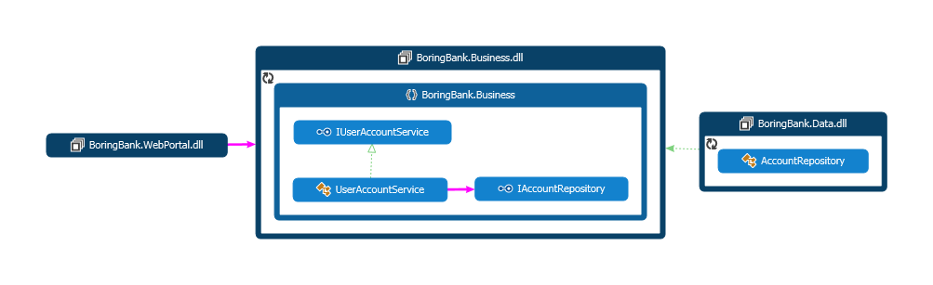
Reusability
Keep Business but
Change UI
Change Storage
or CLI
or WPF
or Web API
or WCF
…
or files
or NoSQL
or Azure
or Http Client
…

Slide 34
Late-binding
Dynamically decide which implementation to use
protected override IController GetControllerInstance(RequestContext requestContext,
Type controllerType)
{
// how to compose an AccountController ?
if (controllerType == typeof(AccountController))
{
var repo = LoadInstanceFromPluginFolder<IAccountRepository>();
var service = new UserAccountService(repo);
return new AccountController(service);
}
// standard way in MVC to use default strategy
return base.GetControllerInstance(requestContext, controllerType);
}
Plugin scenarios

Slide 35
Extensibility
public class CachedAccountRepository : IAccountRepository
{
private readonly ICache _cache;
private readonly IAccountRepository _decorated;
public CachedAccountRepository(ICache cache, IAccountRepository decorated)
{
if (cache == null) throw new ArgumentNullException("cache");
if (decorated == null) throw new ArgumentNullException("decorated");
_cache = cache;
_decorated = decorated;
}
public IReadOnlyList<Account> GetAccountsForCustomer(int userId)
{
var accounts = _cache.GetOrAdd("accounts_" + userId,
() => _decorated.GetAccountsForCustomer(userId));
return accounts;
}
Decorator
Decorator Pattern
Very DI-friendly pattern
Example : caching
var nakedRepo = new AccountRepository(connectionString);
// decorate the nakedRepository with caching features
var longCache = new DotNetCache(TimeSpan.FromHours(1));
var cachedRepo = new CachedAccountRepository(longCache, nakedRepo);
var service = new UserAccountService(cachedRepo);
delegate to decorated instance
Notes:
Traditionnal approach would be :
Modify code
Subclass..

Slide 36
DI COntainers

Slide 37
DI Container – how they work
Maintain a mapping between Abstraction and Concrete Type
Usually initialized on app start
Methods like Register<IAbstraction,ConcreteType>()
Method Resolve<TRequired>()
Recursively resolves dependencies reading constructor parameters

Slide 38
Example
public class DependencyConfig
{
public static void Configure(IUnityContainer container)
{
var connectionString = ConfigurationManager.ConnectionStrings["BankingDbContext"]
.ConnectionString;
container.RegisterType<IAccountRepository, AccountRepository>(
new InjectionConstructor(connectionString));
container.RegisterType<IUserAccountService, UserAccountService>();
}
}
In DependencyConfig
public class MvcApplication : System.Web.HttpApplication
{
protected void Application_Start()
{
var container = new UnityContainer();
DependencyConfig.Configure(container);
var compositionRoot = new AppCompositionRoot(container);
ControllerBuilder.Current.SetControllerFactory(compositionRoot);
In Global.asax
public class AppCompositionRoot : DefaultControllerFactory
{
private readonly IUnityContainer _unityContainer;
public AppCompositionRoot(IUnityContainer unityContainer)
{
if (unityContainer == null) throw new ArgumentNullException("unityContainer");
_unityContainer = unityContainer;
}
protected override IController GetControllerInstance(RequestContext requestContext, Type controllerType)
{
return (IController) _unityContainer.Resolve(controllerType);
}
}
In CompositionRoot
Register / Resolve (/ Release)

Slide 39
Aspects of DI
Composition
Lifetime Management
Interception

Slide 40
LifeTime Management

Slide 41
Interception
~ Dynamic Decorators
Cross-cutting concerns
Logging
Auditing
Profiling …
AOP-like !

Slide 42
Example with Unity
public class TimingBehavior : IInterceptionBehavior
{
public IMethodReturn Invoke(IMethodInvocation input, GetNextInterceptionBehaviorDelegate getNext)
{
var stopwatch = new Stopwatch();
// Before invoking the method on the original target.
Debug.WriteLine("> {0}.{1}", input.MethodBase.DeclaringType, input.MethodBase.Name);
stopwatch.Start();
// Invoke the next behavior in the chain.
var result = getNext()(input, getNext);
stopwatch.Stop();
// After invoking the method on the original target.
if (result.Exception != null)
{
Debug.WriteLine(
"< {0}.{1} failed - after {3} ms",
input.MethodBase.DeclaringType, input.MethodBase.Name, result.Exception.GetType(), stopwatch.ElapsedMilliseconds);
}
else
{
Debug.WriteLine("< {0}.{1} - after {2} ms",
input.MethodBase.DeclaringType, input.MethodBase.Name,
stopwatch.ElapsedMilliseconds);
}
return result;
}
public class DependencyConfig
{
public static void Configure(IUnityContainer container)
{
container.AddNewExtension<Interception>();
var connectionString = ConfigurationManager.ConnectionStrings["BankingDbContext"]
.ConnectionString;
container.RegisterType<IAccountRepository, AccountRepository>(
new InjectionConstructor(connectionString),
new Interceptor<InterfaceInterceptor>(),
new InterceptionBehavior<TimingBehavior>());
container.RegisterType<IUserAccountService, UserAccountService>(
new Interceptor<InterfaceInterceptor>(),
new InterceptionBehavior<TimingBehavior>());
}
}
Call to decorated instance

Slide 43
Conclusion
TODO ☺

Slide 44
Remember
Constructor Injection is your friend
DI-friendly everywhere
DI Container should be visible only in Composition Root

Slide 45
Going further …
Mark Seemann’s book and blog posts
Conversation about DI in aspnet vNext
SOLID
TODO

Slide 46
Q&a
Shoot !

Slide 47
Thanks for attending !
Contact : @tsimbalar

Slide 48
EXTRAS
You want more ?

Slide 49
anti-pattern : Service Locator

